Slide 1


jkuat first agges meeting 2020
tech house

Slide 2
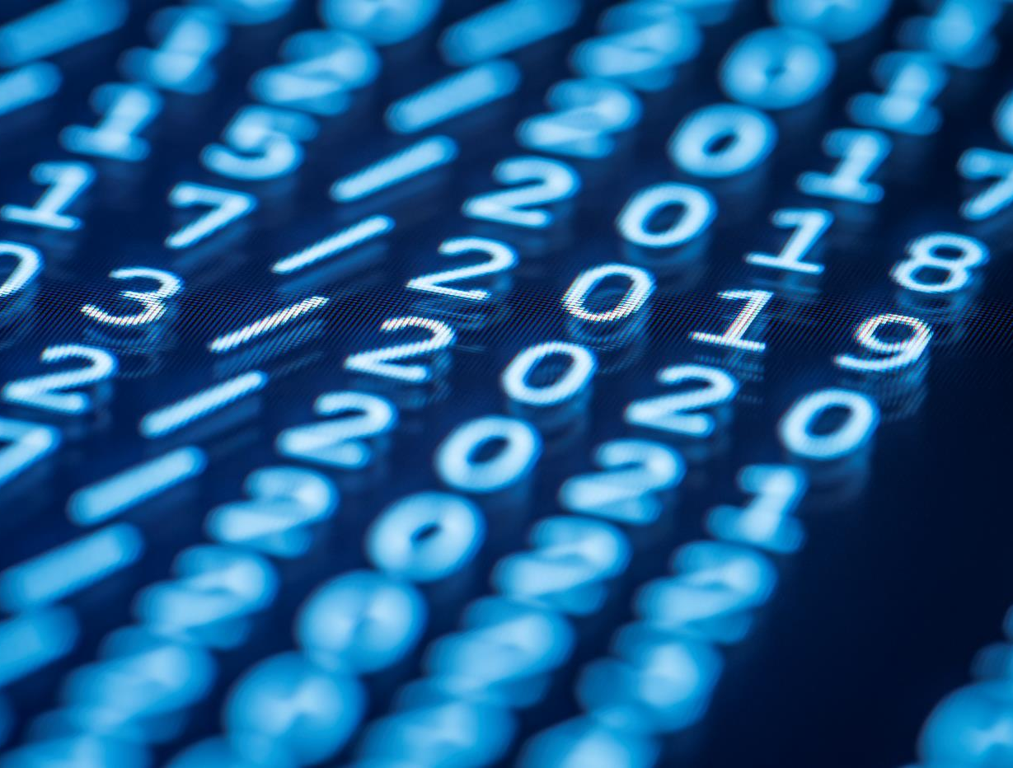
FEEL WelcomeD GUYS

Slide 3
agenda
We’ll briefly discuss on:
HTML
Web map
Json
Pandas package for data science
Folium packages
Python module and python packages
Python APIs

Slide 4
1.HTML
HTML briefly stands for Hypertext Markup Language
It’s a Standard Markup Language for documents designed to be displayed in a web browser.

Slide 5
2. Web map
This is a process of using the maps delivered by Geographic Information Systems in World Wide Web.
Web Mapping on the WWW is both served and consumed thus its more than Web Catography.
So in web mapping the consumer may choose what the map will show.

Slide 6
3. json
JSON stands for Javascript Object Notations.
It’s a lightweight formart for storing and transporting data. Its often used when data is sent from a server to a web page.

Slide 7
4. Pandas package for data science
In computer programming, pandas is a software library written for the python programming language for data manipulation and analysis
Pandas also provides us with very powerful objects like data frames and series which are very useful for working with and analyzing data

Slide 8
5. Folium packages
Before getting a clear picture on what folium packages is we will come across the following words;
Data wrangling- This is basically data cleaning or in other words the removal of errors in your special data.
Leaflet JS- This is generally an APIs used in mapping.
APIs which stands for
Application Programming Interface can be borrowed online and used in your code.
Therefore a folium is a package/library for creating interactive basemaps and in which a folium builds on the data wrangling strengths of the python ecosystem and the mapping strengths of the Leaflet JS library so manipulate your data in python then visualize it in a leaflet map via folium.

Slide 9
6. Python module/python packages
A python is an interpreted high level, general purpose programming language. It was created by Guido Van Rossum which was first released in 1991.
A module on the other hand is a file consisting of a python file/a single python file.
A package is a collection of Python Modules

Slide 10
7. Python apis
Many Internet companies such as facebook, google and twitter provides Programming Interfaces that you can use to build your own applications.
An API is a set of programming instructions and standard for accessing web based software applications.

Slide 11
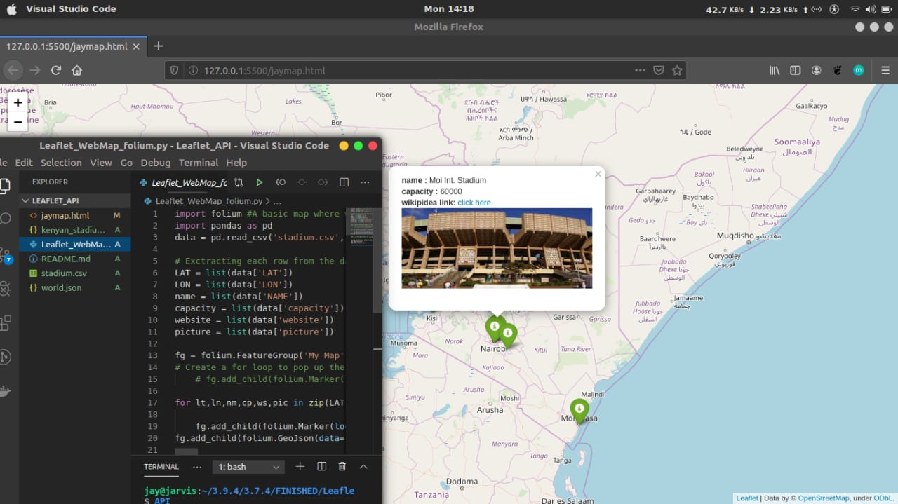
k

Slide 12
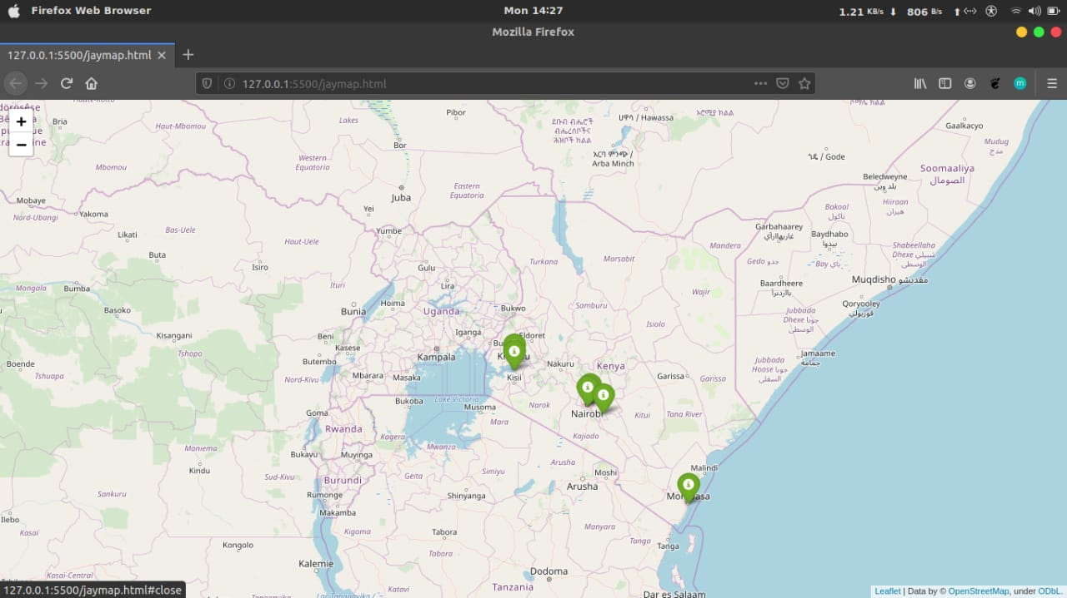

Slide 13

A presentation created by
JACOB OKOMO
VALLERY
THANK YOU ALL.

